Slide 1
Tools
Basic Tools and Supply Chain
Notes:
Main Title Page

Slide 2
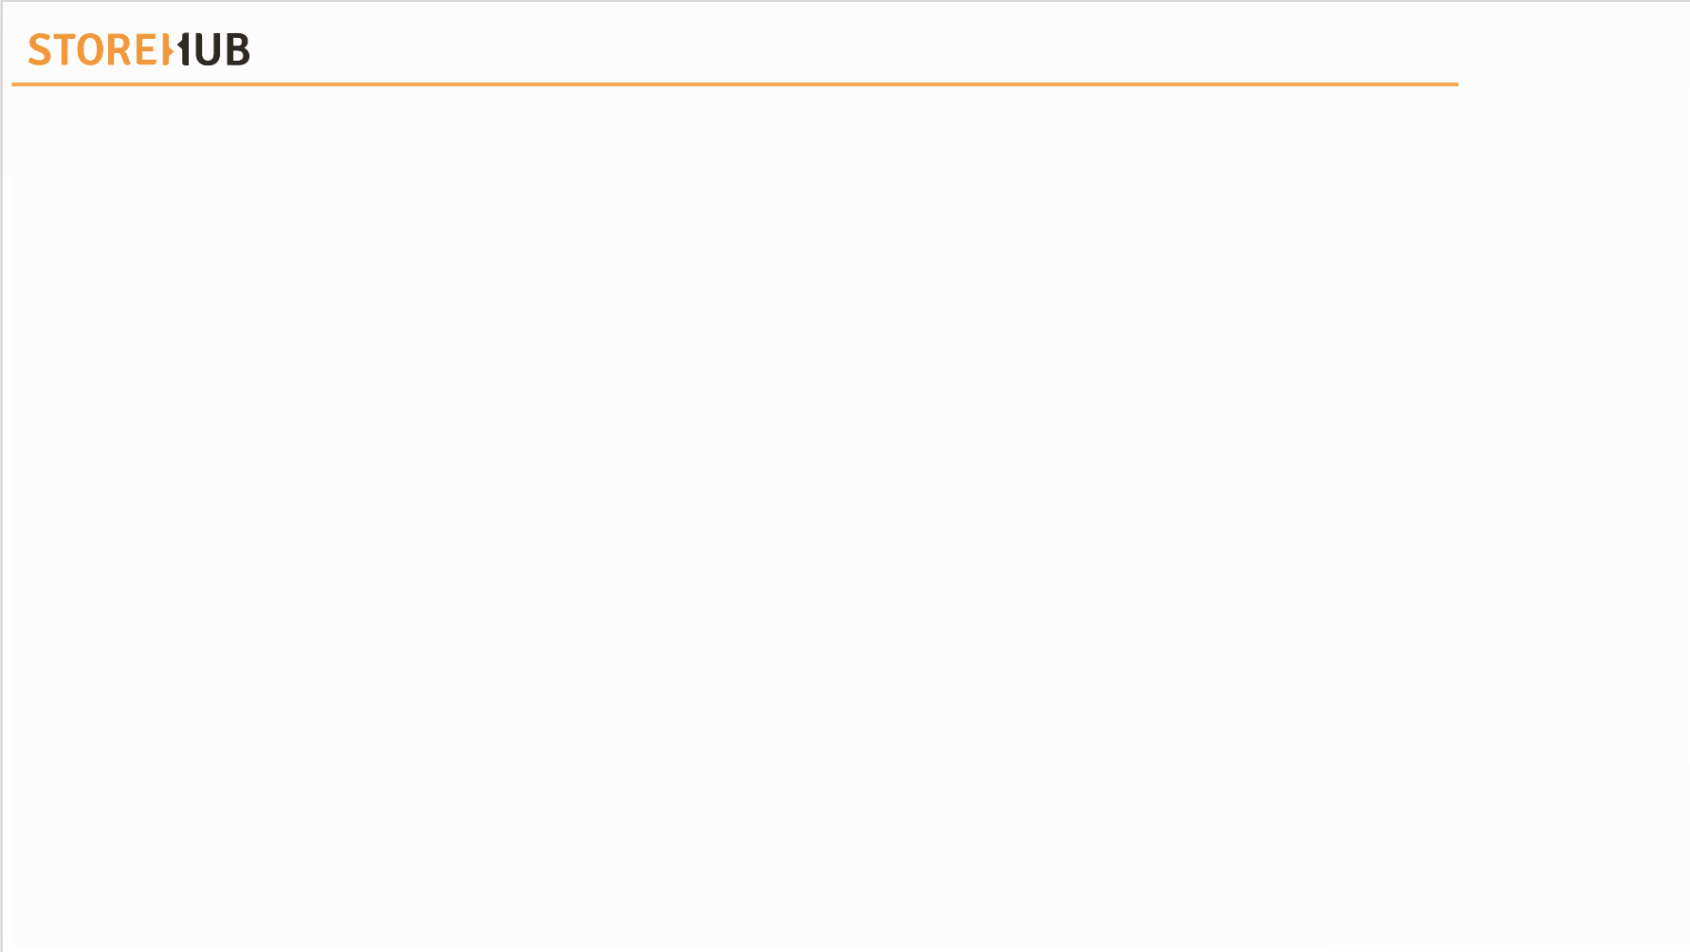

| Mechanism
Directory Index
Date | Updates | Version | PIC

Slide 3


| Mechanism
Overview
Tools
Supply Chain

Slide 4
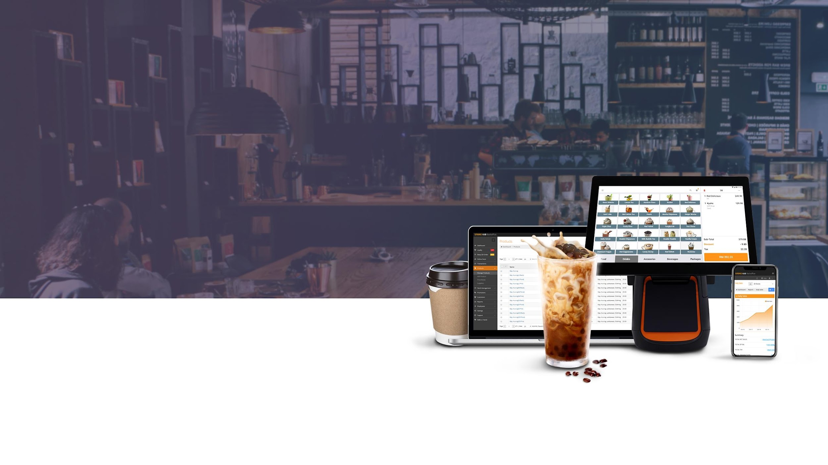
Tools

Slide 5








| Mechanism
Main Tools
Internal Support Tool
Internal & External KB
Salesforce
Chargebee
Forms
Intercom
Zoom
Aircall

Slide 6


[ Team Using : All ]

Slide 7

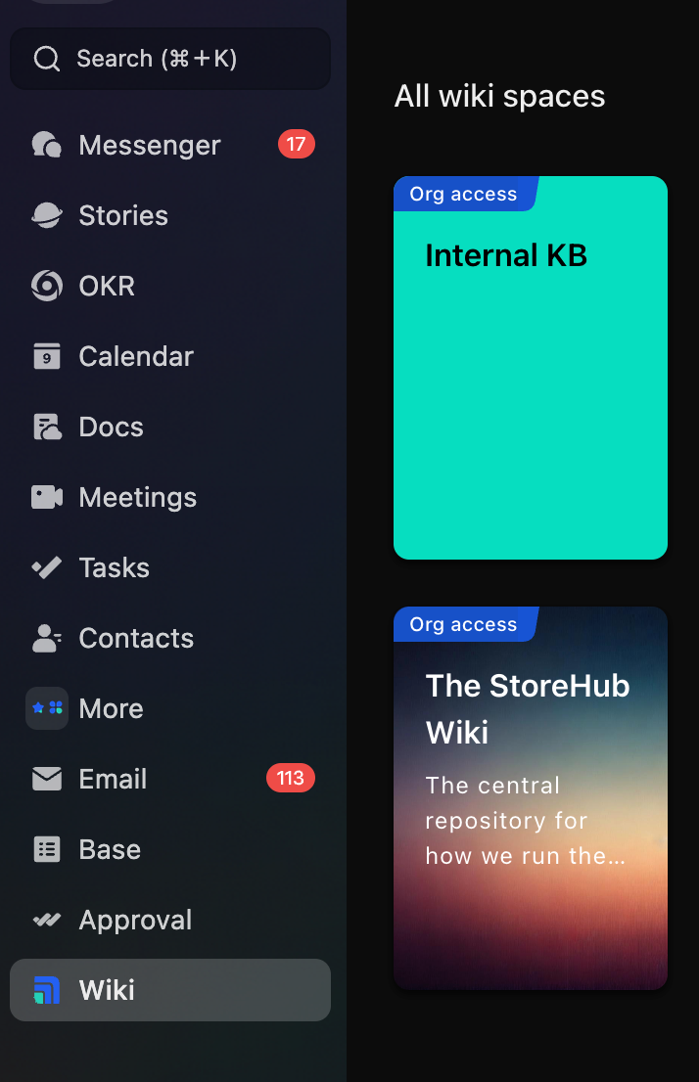
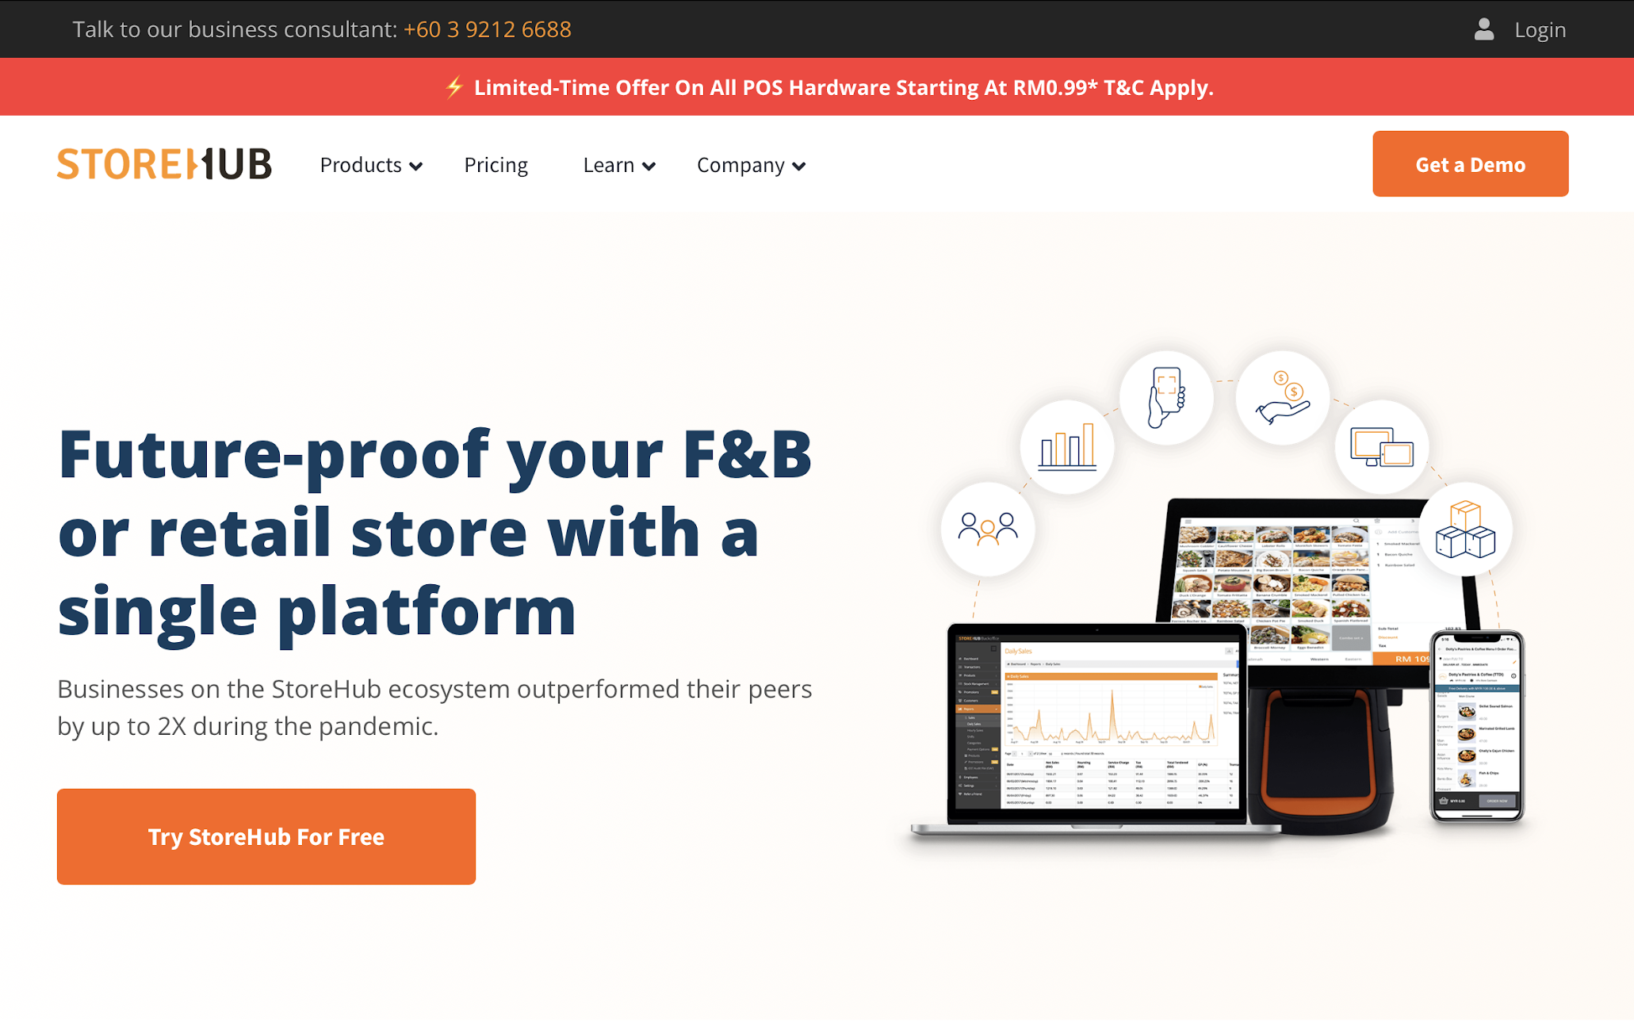
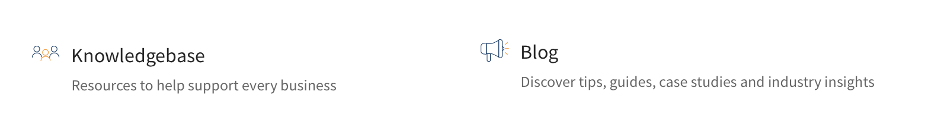
Knowledge Base
Introduction
Internal KB Library
Available at https://www.storehub.com/
Available at Lark Wiki
KB = Knowledge Base

Slide 8
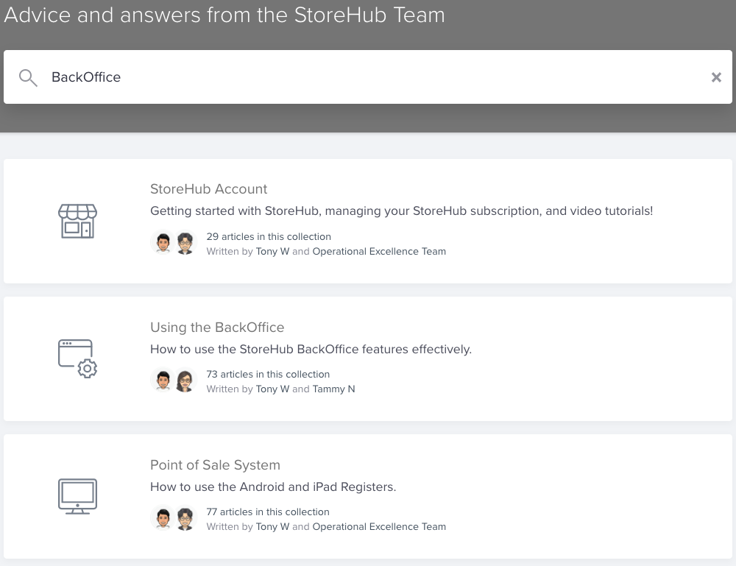
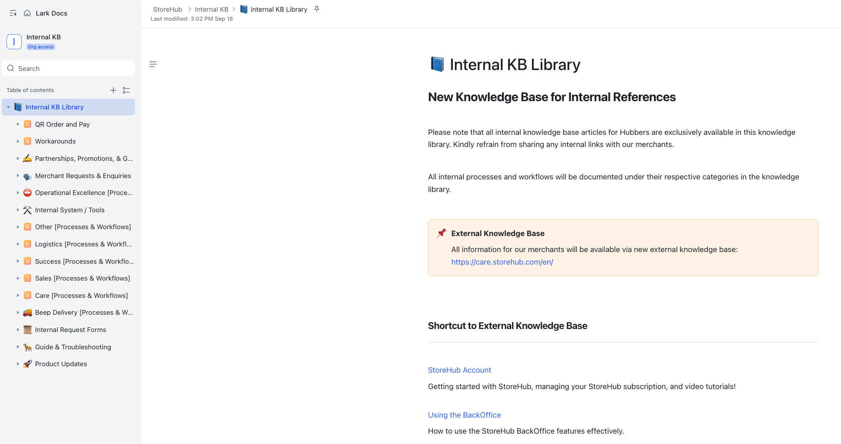
Knowledge Base
Navigation
Internal KB Library
Search Box
Search Box
Categories
Categories
KB = Knowledge Base

Slide 9
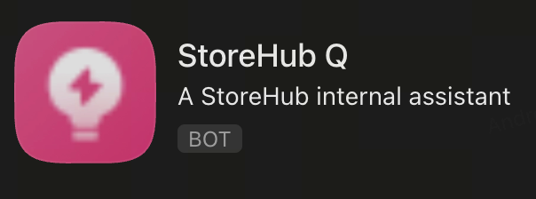
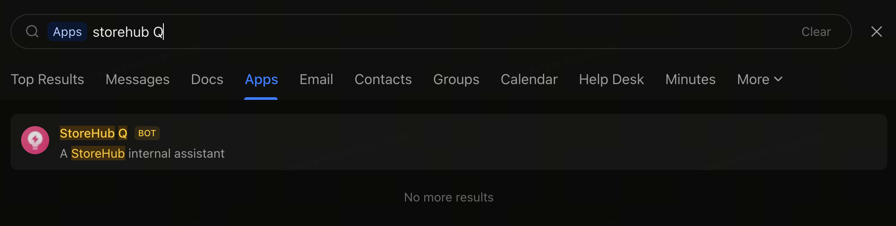
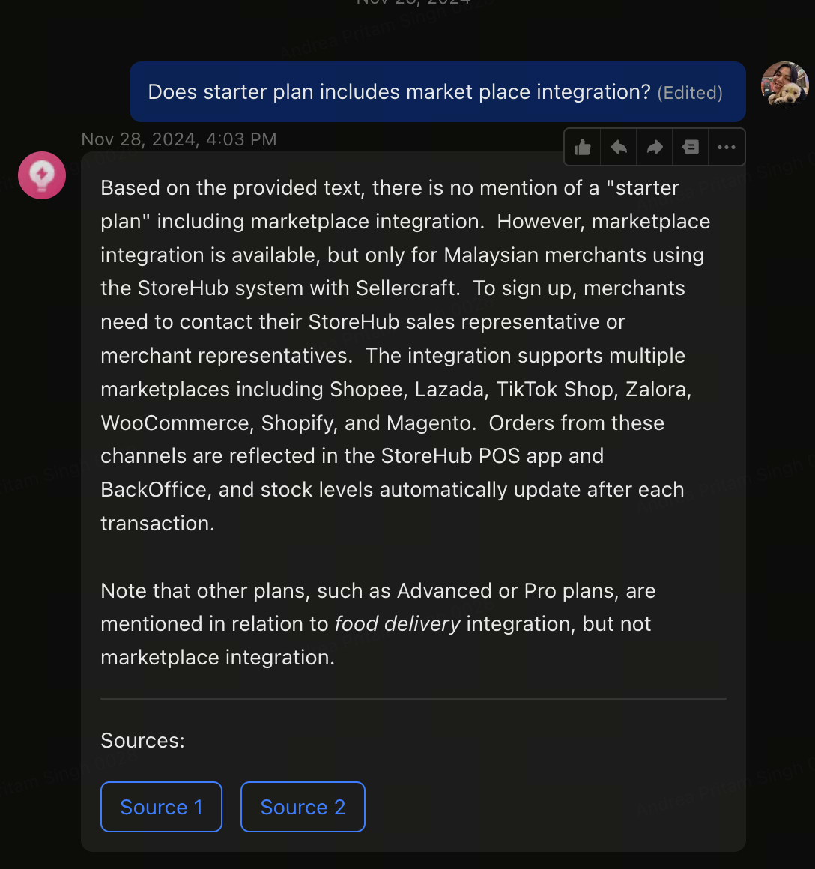
Knowledge Base
Navigation
Search for StoreHub Q on Lark
Have a question about StoreHub? Just ask StoreHub Q for answers!
What is StoreHub Q?
StoreHub Q is an AI-powered assistant designed to gather information from StoreHub’s resources, helping you provide accurate and efficient answers.
KB = Knowledge Base

Slide 10

IST – Internal Support Tool
[ Team Using : Beep / Fleet / Care/ Onboarding ]
Notes:
Change slide

Slide 11

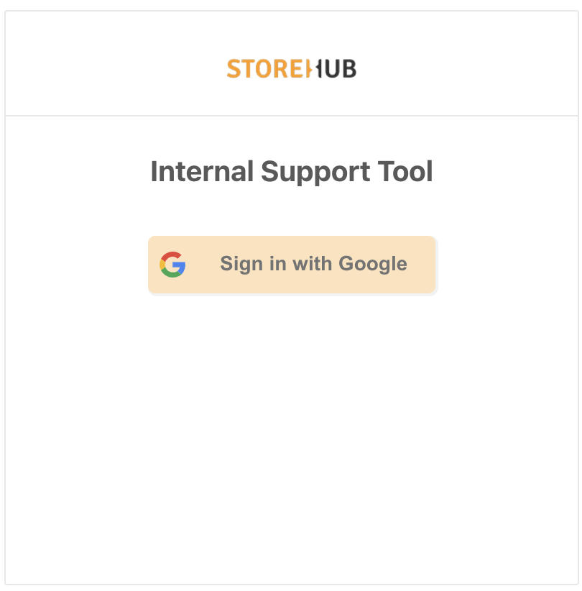


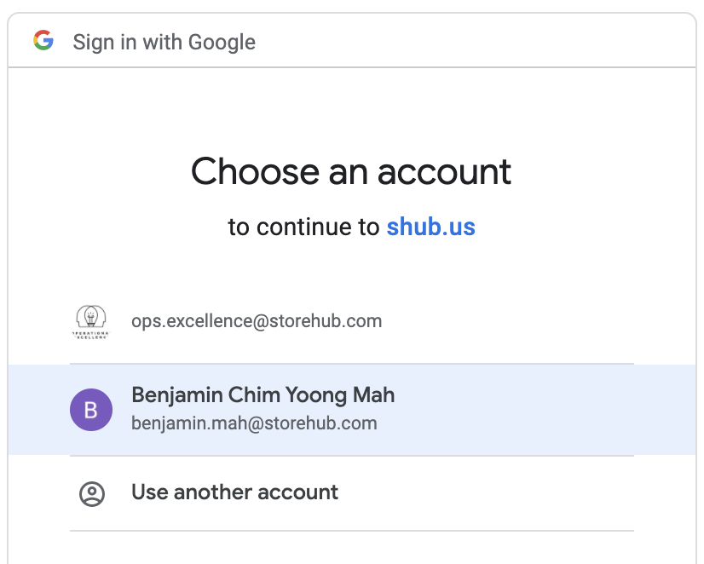
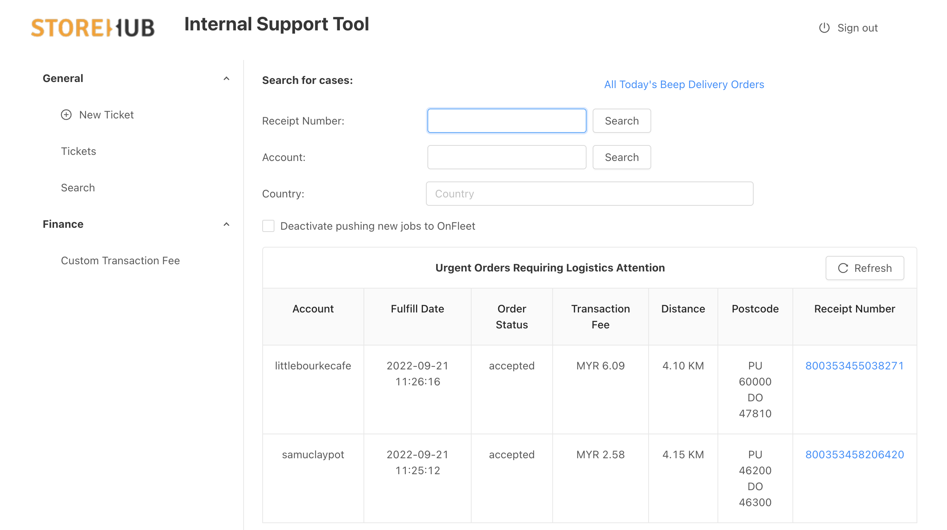
IST – Internal Support Tool
Internal
Support
Tool
Introduction
Login
Links:
https://internal.shub.us/logistics/dashboard
Functions
Create Temp. Employee Access

Slide 12
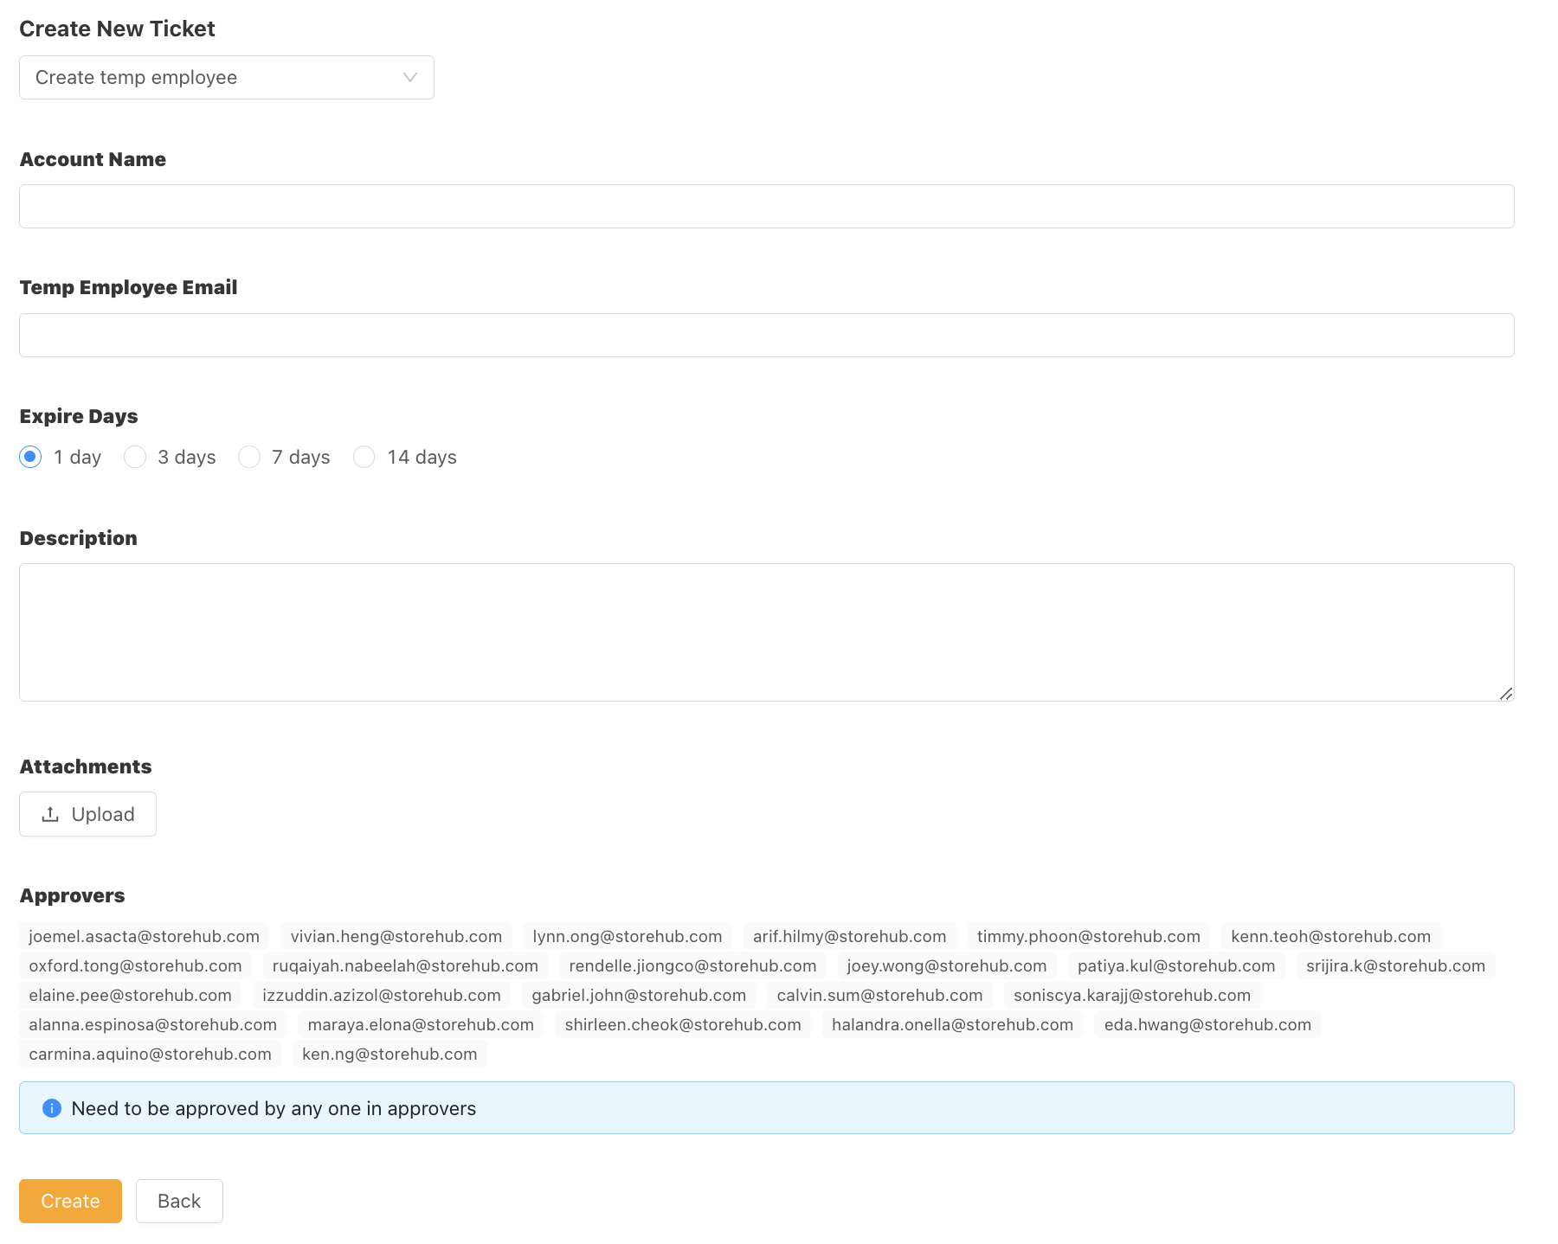
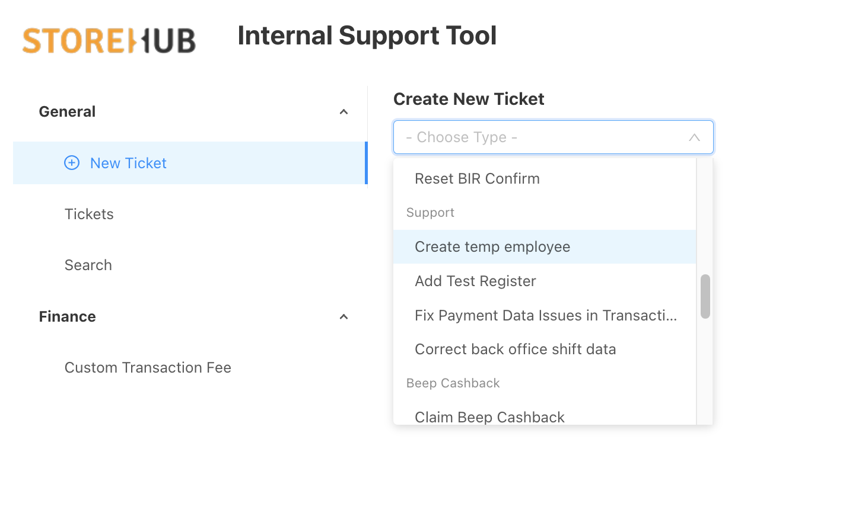
IST – Internal Support Tool
Internal
Support
Tool
Temporary Employee Access
MSM is required to submit a ticket to get temporary access to merchant’s BackOffice.
Notes:
803907798012155

Slide 13
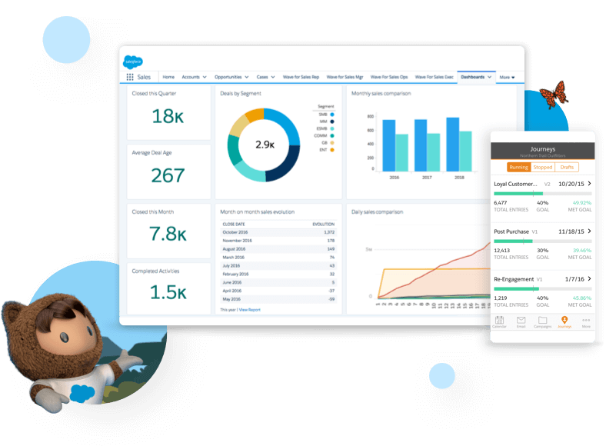

Salesforce
[ Team Using : Sales/Success/Care ]

Slide 14

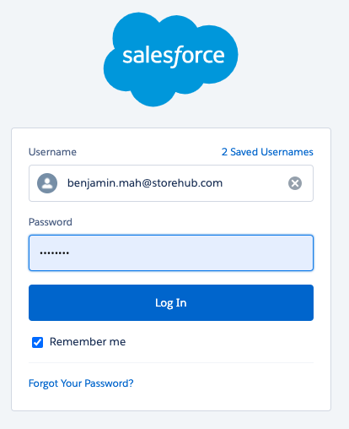
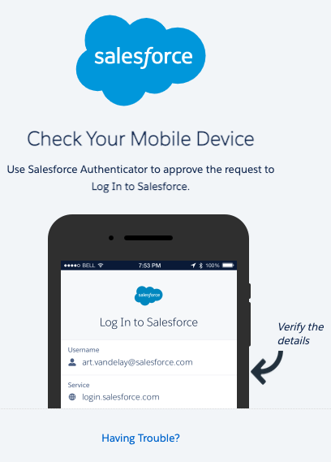
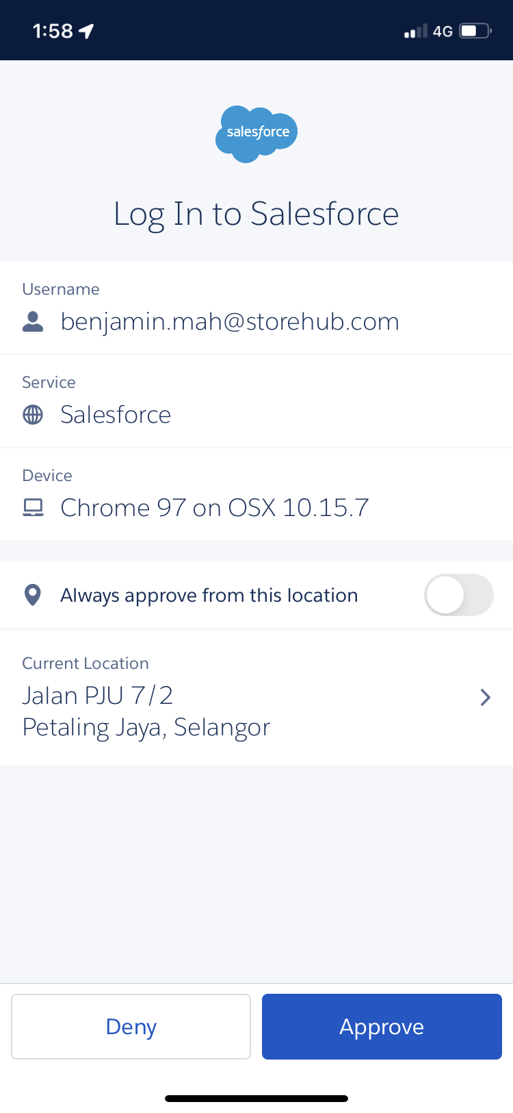
Salesforce
Login
https://storehub.my.salesforce.com/
Verify authentication by downloading Salesforce Authenticator app
Click approve on Authenticator app

Slide 15
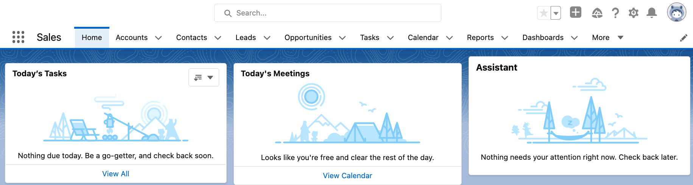
Salesforce
Introduction
Intro
Function
Used by
Managing merchant’s StoreHub journey
Lead > Won > Onboarding
Qualifying leads
Merchant’s information
Onboarding schedule
Hardware tracking
Sales Team
Success Team
Care Team

Slide 16
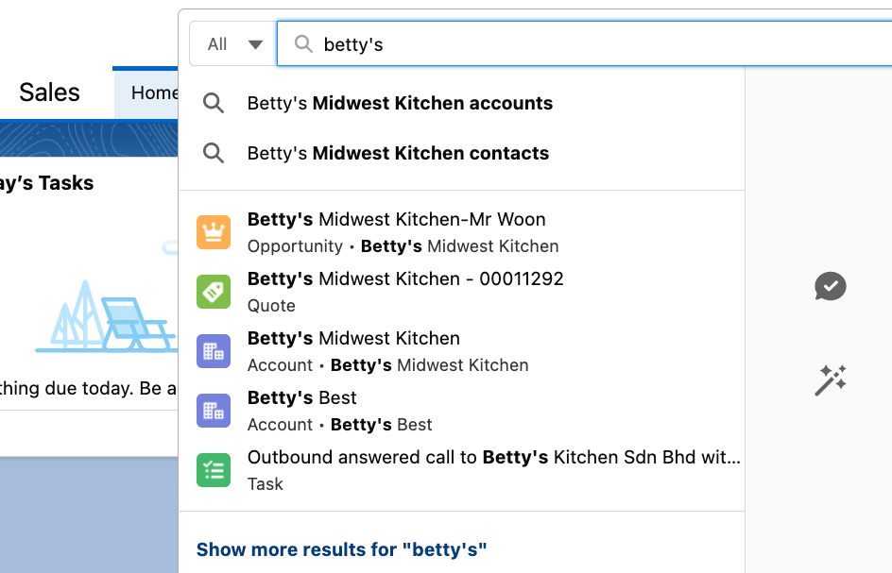
Salesforce
Navigation (cont.)
Search Input :
Account name
Email
PIC
Select Salesforce Objects:
Lead - New Lead (Qualified/Unqualified)
Opportunity - Meeting Completed by BC (Won/Lost)
Account - Overview of merchant’s Account Details
Contact - Merchant’s Contact Info
PIC = Person in Charge

Slide 17
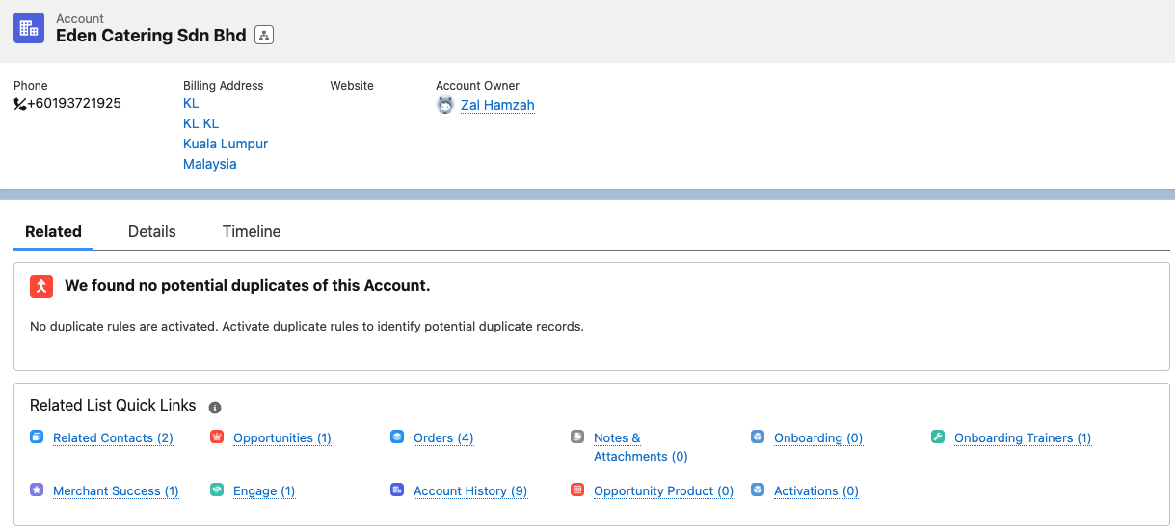
Salesforce
Navigation (Account)
Opportunities can be found under Account
MSM Pipeline
Onboarding Pipeline
PIC = Person in Charge

Slide 18
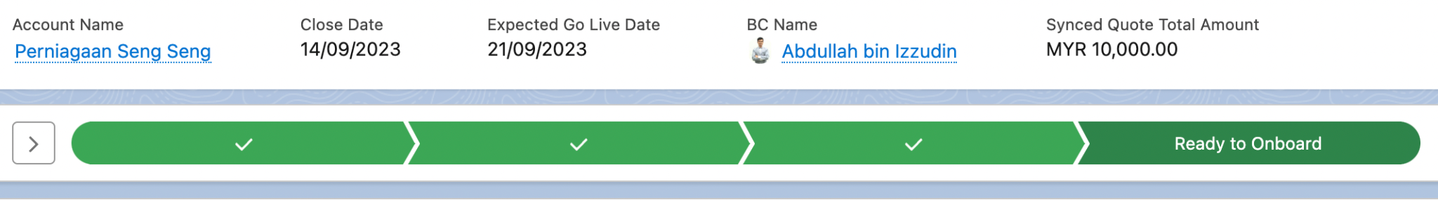
Salesforce
Navigation (Opportunity)
Paid Subscription: Account is still in the Sales pipeline.
Ready to Onboard: Already pushed to the Onboarding team to complete the checklist

Slide 19
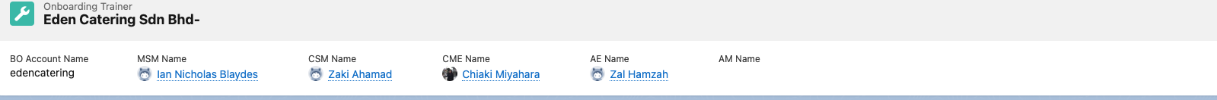
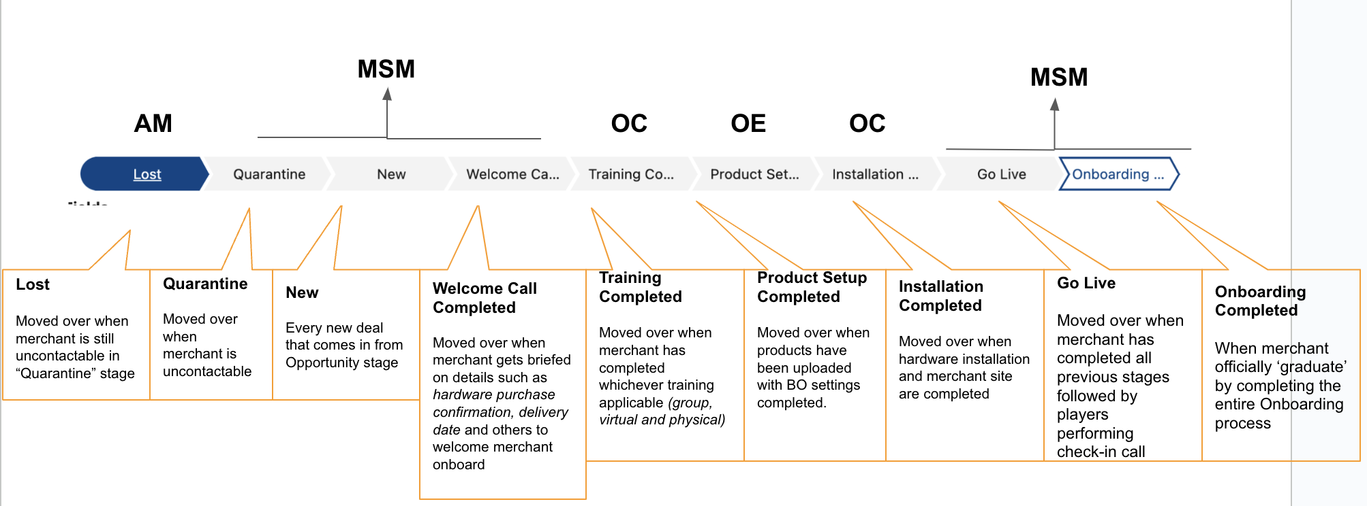
Salesforce
Pipeline (Onboarding Trainers)
Name of Assignees from each department
MSM is responsible for merchants at these stages

Slide 20
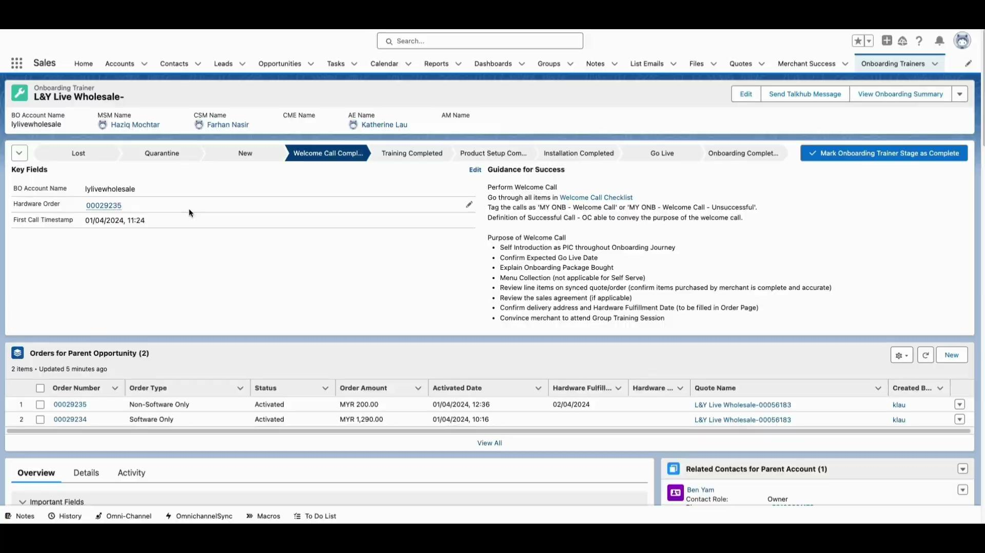
Salesforce
Navigation (Onboarding Trainers)
Learn how to navigate in Salesforce using a real account here!

Slide 21
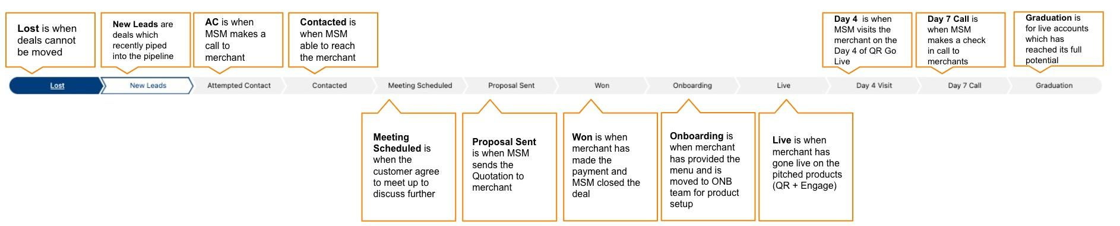
Salesforce
Pipeline (Merchant Success Manager)

Slide 22
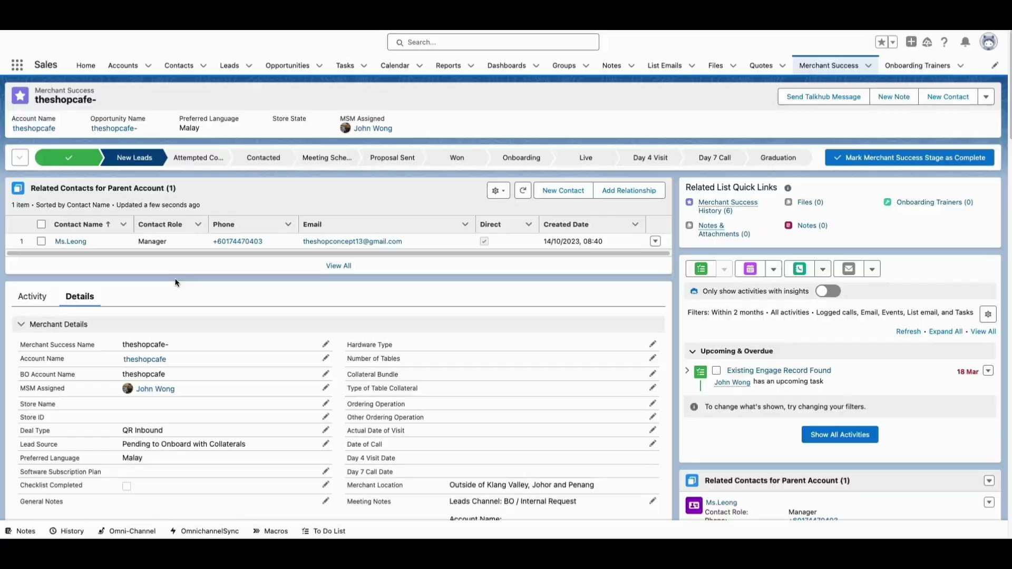
Salesforce
Navigation (Merchant Success Manager)
Learn how to navigate in Salesforce using a real account here!

Slide 23


[ Team Using : Account Management / Care ]

Slide 24
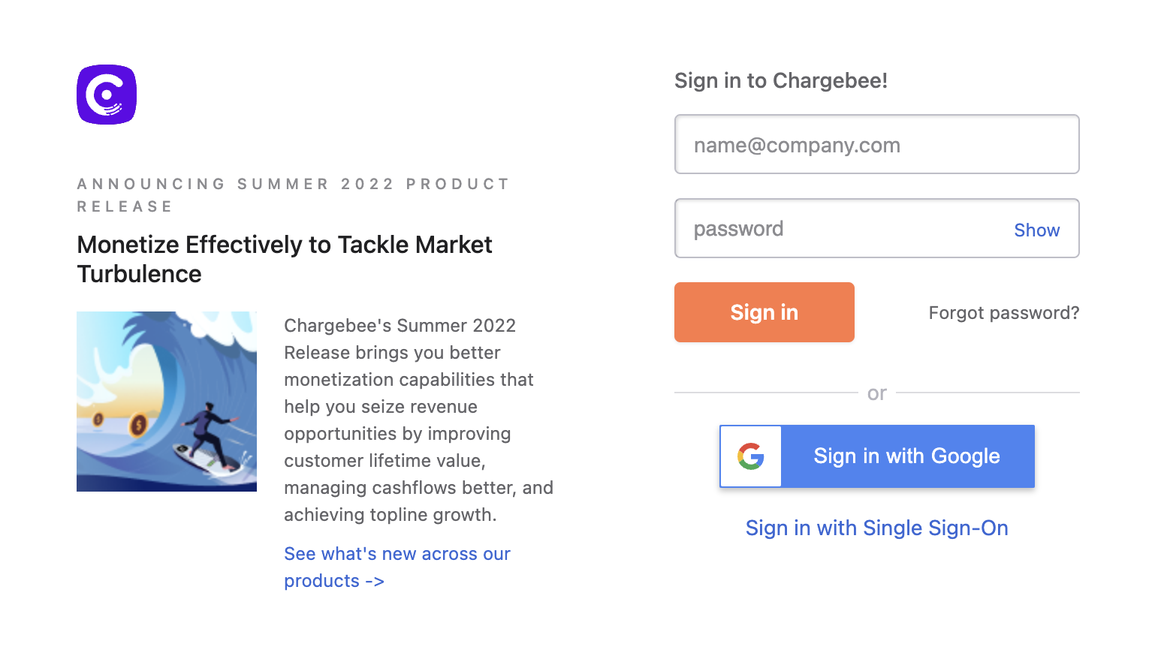
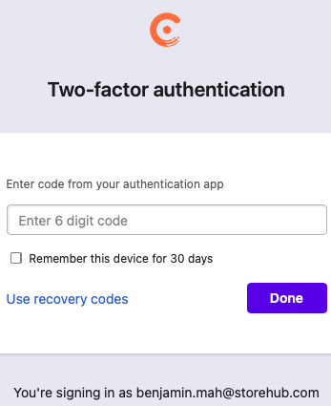
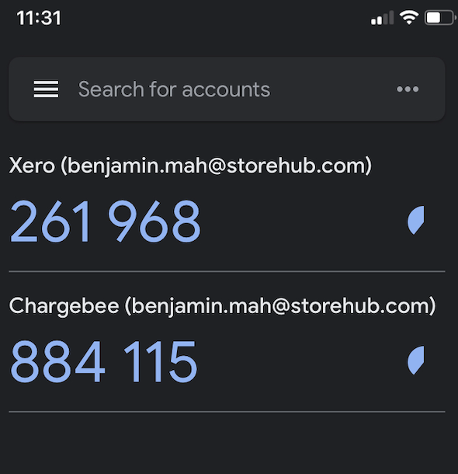
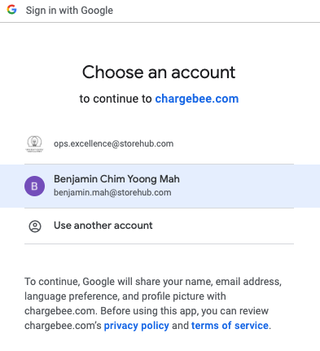
Chargebee
Login
https://app.chargebee.com/
Verify authentication by downloading Google Authenticator app
Once added, key in the same 6 digit code in the web page
Sign in with Google account
App = Application

Slide 25
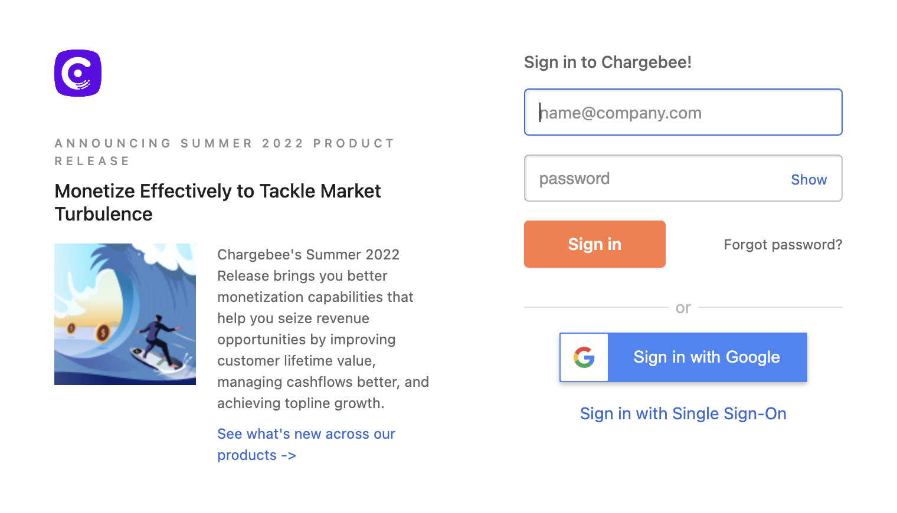
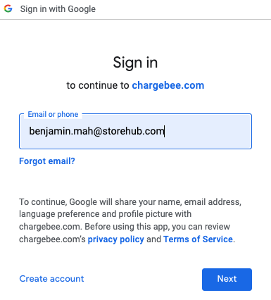
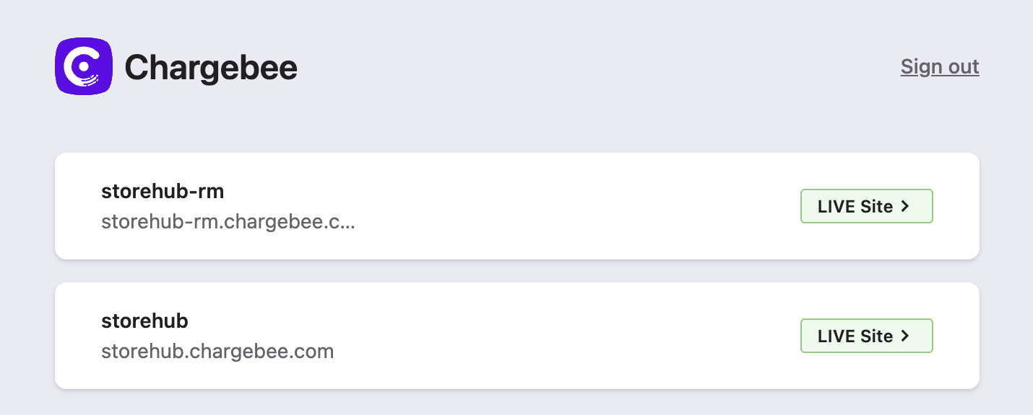
Chargebee
Introduction
https://app.chargebee.com/
Functions
View merchant’s subscription details
Edit merchant’s subscription
Mainly used by:
Account Management Team
Care Team
storehub-rm.chargebee.com
[Malaysian accounts only]
storehub.chargebee.com
[All accounts except Malaysian account]

Slide 26
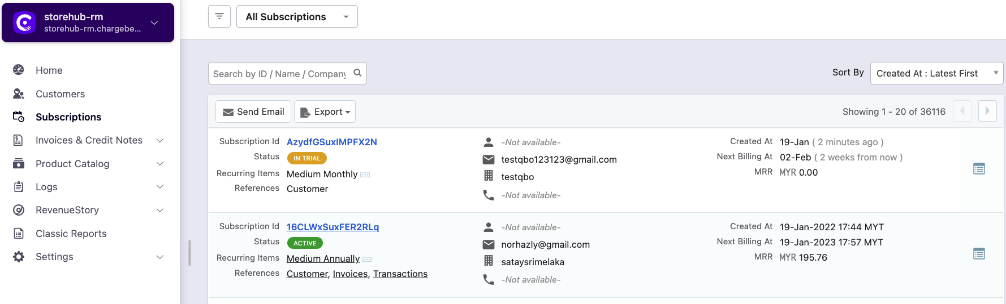
Chargebee
Navigation
Customers
Subscriptions
View contact information of merchant
Limited information on merchant subscription details
Merchant’s detailed subscription information
View charges and payment information of subscription

Slide 27
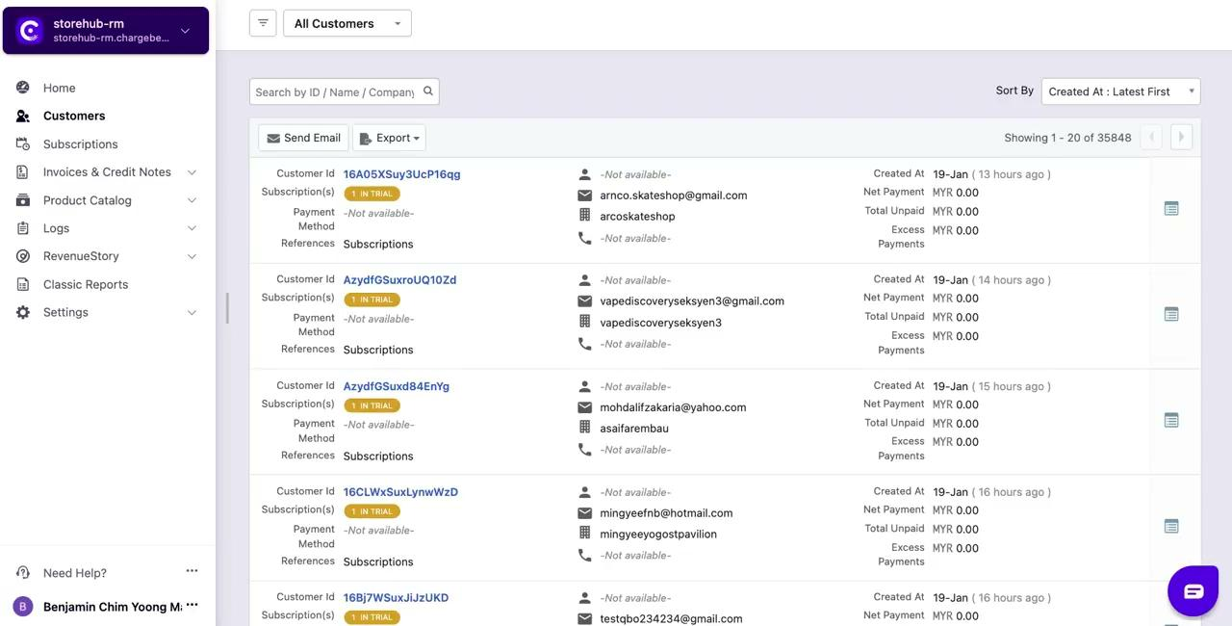
Chargebee
Navigation - Video

Slide 28
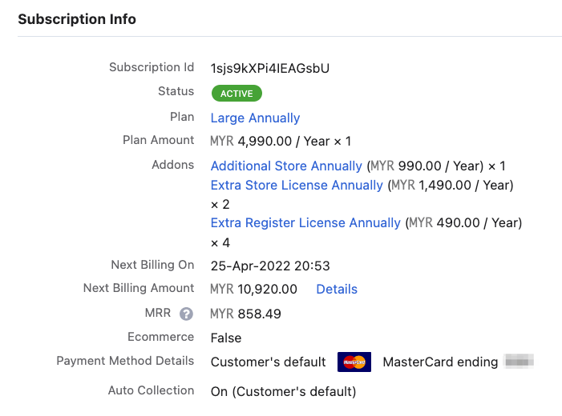
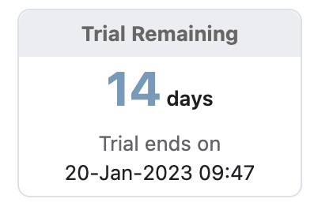



Chargebee
Subscription Details
Active
Merchant’s plan is still active
Cancelled
Merchant cancelled their plan
In Trial
Merchant recently register with StoreHub
Merchant Subscription Plan (Annually / Monthly)
Small: Starter Plan
Medium: Advance Plan
Large: Pro Plan
Base Plan: Base Plan
Additional Store [Extra store license]
Country | Pricing (Yearly)
 | MYR 1,490
 | PHP 490
 | THB 12,500
Additional Register [Extra POS terminal in existing store]
Country | Pricing (Yearly)
 | MYR 490
 | PHP 190
 | THB 6,000
SH = StoreHub

Slide 29
Chargebee
Subscription Details
Next Billing On
When will SH charge
Next Billing Amount
Total Charges
MRR
Monthly Recurring Revenue
Payment Method
Card: Auto charge / Auto debit
Blank: Manual payment
SH = StoreHub

Slide 30
Intercom

Slide 31

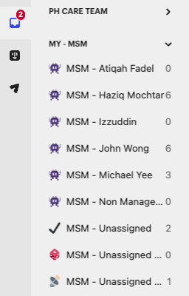
Intercom
Onboarding (MSM Team View)
When to use?
When players wish to check their own bucket or specific teammates’ bucket
MSM Team View
On the Intercom ‘Inbox’ tab, search for MSM Team View’ Option
Select the desired MSM’s name
OE = Onboarding Executive | OC = Onboarding Consultant

Slide 32
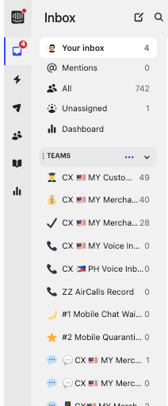
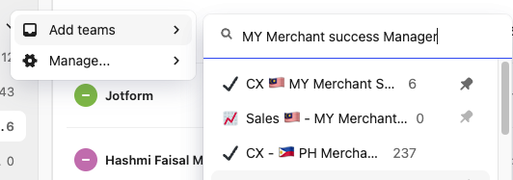
Intercom
Team Search
When to use?
When players wish to locate team and retrieve conversations
Team Search
On the Intercom ‘Inbox’ tab, search for ‘Teams’ option
Hover cursor over to 3 dots button and click on it
Select ‘Add teams’ then type and search for “CX 🇲🇾 MY Merchant Success Manager”

Slide 33

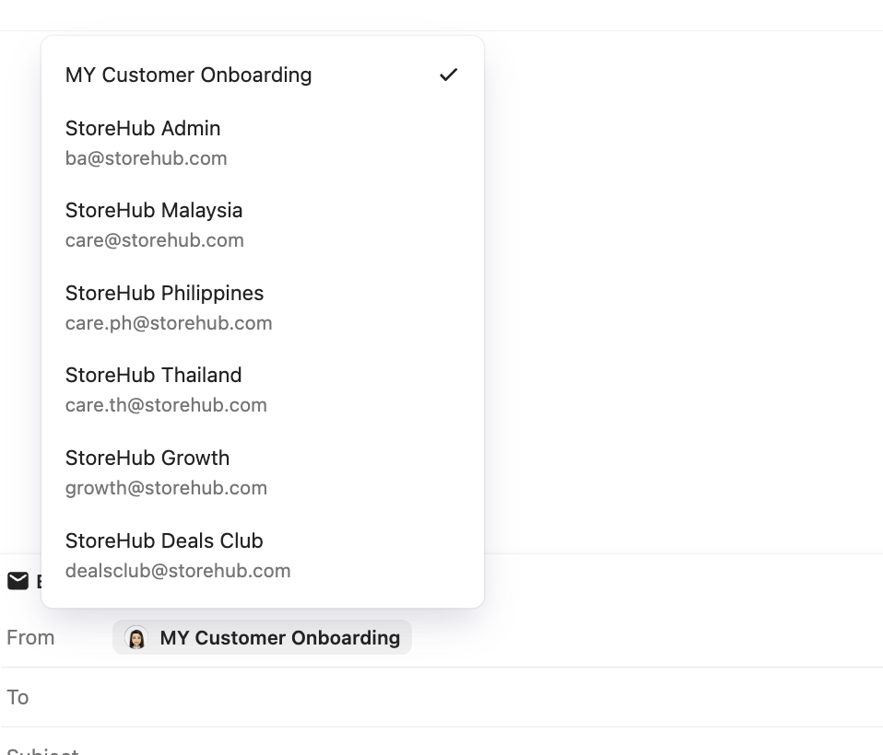

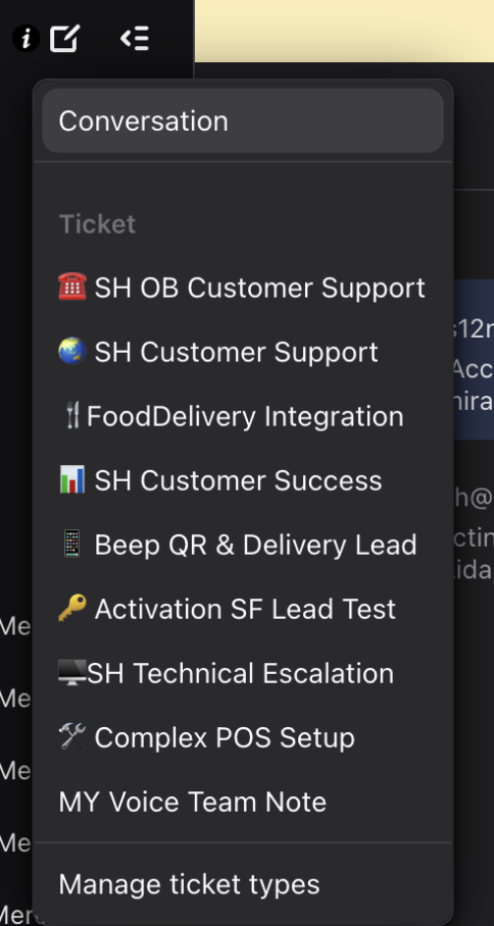
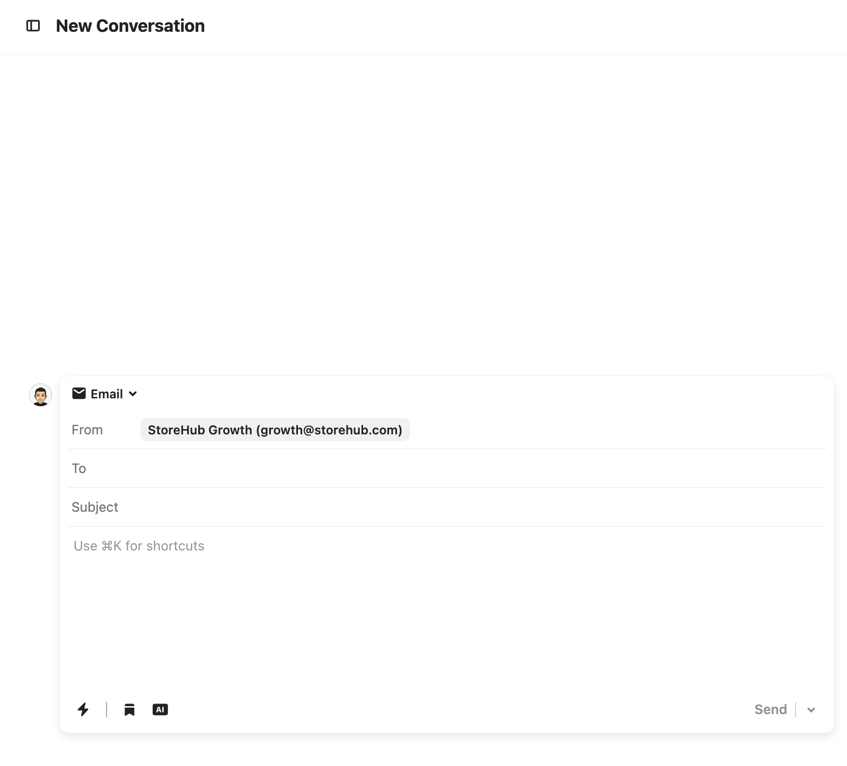
Email
Creating Outbound Email
4
1
2
Steps
Create a new box conversation
Select “Conversation”.
Select “Email”.
Select ‘MY Customer Onboarding’
Fill in Subject > Type in the content > Send
3
5

Slide 34
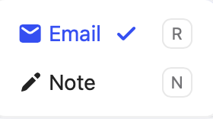
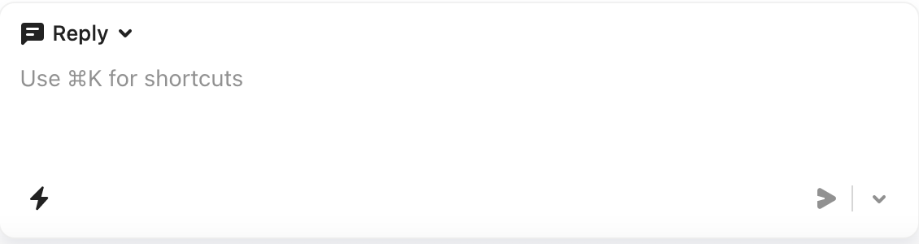
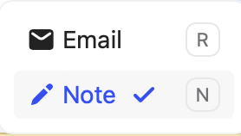
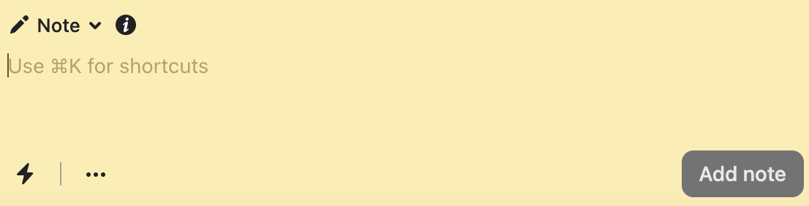
Email
Reply vs. Note
Reply
Player reply to customer tickets by adding contents
Internal Note
Player leave internal note for the case (It is not visible to merchant / customer view)

Slide 35
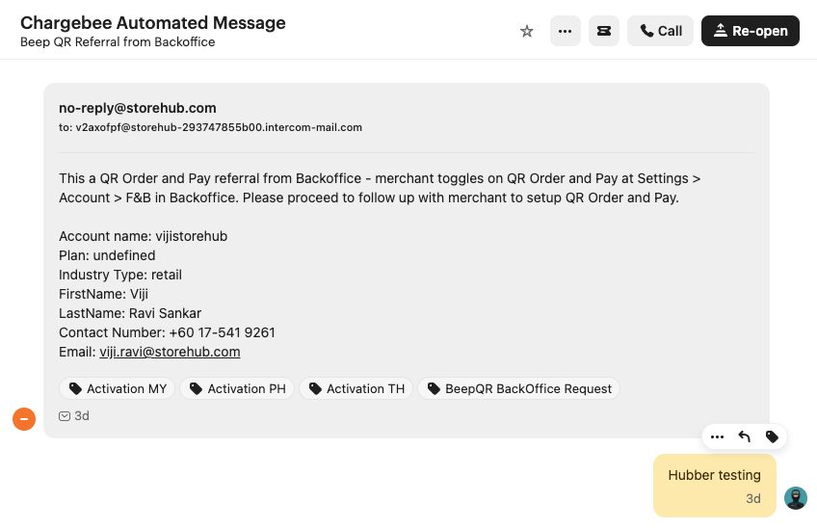
Intercom
Conversation Type
QR order and Pay
When merchant toggles on QR order and Pay on BackOffice, an automated message will be send to MSM’s bucket to contact merchant.
Example ticket here

Slide 36

Intercom
Conversation Type (Cont.)
Food Delivery Integration
When merchant submits a request for Food Delivery Integration
Example ticket here

Slide 37

Intercom
Conversation Type (Cont.)
Engage Lead
When merchant submits to Try for Free Now on Engage and MSM will need to contact to upsell
Example ticket here

Slide 38

Intercom
Conversation Type (Cont.)
QR Order and Pay
When merchant wants to purchase QR Order and Pay
Example ticket here

Slide 39



Basic Functions
Ticket Escalation (Create New Ticket)
Ticket Creation
Select the relevant ticket to be created
When to use?
When issue requires other team (Account Management, Onboarding, MSM, Care) to follow up. Inform merchant to expect contact within 2 working days. (E.G: Renewal, Activation, Onboarding)
OB = Outbound

Slide 40

Basic Functions
Ticket Escalation (Cont.)
Escalation from Other department > Care T1 for Hardware/Software/BackOffice troubleshooting requests
Escalation from Care > Success (Onboarding/Account Management/MSM) for account/onboarding related requests
OB = Outbound

Slide 41
Aircall

Slide 42



Aircall
Download Aircall
Open Apple Apps Store on your Macbook
Search “Aircall” on the search bar

Slide 43

Aircall
Download Aircall (cont.)
Click “GET” to download Aircall on your Macbook

Slide 44

Aircall
Outbound Call

Slide 45
Google Meet

Slide 46


Google Meet
Check Meeting Scheduled
Click on Google Menu
Click on the Calendar
Refer to Meeting Scheduled

Slide 47



Google Meet
Join Google Meet
_
Click on the Google meet link
Click on ‘Join Now’
Click on ‘Manage Recording

Slide 48




Recording
Record a Meeting
_
Click on Start
_
Click on Start
Click on Start Recording
Call is Recorded

Slide 49



Recording
Share Screen in a Meeting
_
_
_
Click on Present Now
Select Tab to present
Slides presented

Slide 50
Forms

Slide 51


Forms
Account Activation Request
MSM will submit Account Activation requests through this form.
Request will be received by OE’s via Intercom to process the the activation on Chargebee.

Slide 52

Forms
StoreHub Collaterals Request Form
MSM will submit QR Collaterals requests through this form.
Request will be received by OE’s via Intercom to process the Collaterals for Merchants.

Slide 53

Forms
Collateral Printing
OE will submit this form once QR collaterals has been created using Adobe Illustrator.

Slide 54

Forms
Collateral Printing
Merchants are required to submit this form in case in need for Group Training.

Slide 55


Supply Chain
[ Team Using : Supply / Care ]

Slide 56




Supply Chain
Overview
Introduction
Salesforce
Oracle Netsuite
Delivery Issue

Slide 57


Supply Chain
Introduction
Look out for latest announcements on updates related to:
Supply Chain: Hardware related updates
Business Process: Work process updates
Workplace: CPM Announcement
Click Like for acknowledgement or post question related on the topic posted by the CPM Team

Slide 58






Supply Chain
Introduction
Vendors Used

Slide 59

Supply Chain
Oracle Netsuite
Dashboard

Slide 60
Supply Chain
Quotation & Order Creation
Salesforce
Netsuite
Create Quote
Email Quote & follow up payment
Create Order
Attach Payment Slip
Sales / Success
Approve and activate order
Sync into Netsuite Sales Order
Finance
Update Netsuite Memo as Software / Hardware / Software + Hardware
Close SO
Generate invoice and send to merchant
Process SO & Arrange Hardware Delivery.
The delivery details (tracking link or number) will be synced into SF through integration on daily basis (Salesforce x Vendor Gsheet Integration)
Supply Chain
SO = Sales Order

Slide 61


Supply Chain
Tracking Number in Salesforce
Use Salesforce to search for Supply Chain information such as
Transport Type
Tracking Number / Tracking Link
Delivery Status & Timestamp
SalesForce order dashboard - Here

Slide 62
Supply Chain
Hardware Delivery
Hardware Delivery SLA
Within Klang Valley: Delivery Provider: Lalamove (Default) Same day between 3.00pm - 5.00pm | Outside Klang Valley: Delivery Provider: GDEX Peninsular: Between 3 - 5 days East Malaysia: Between 5 - 7 days
Onsite Service SLA
Case / Ticket creation in Tracking: Cut-off time is 12.00pm daily Tier 2 will contact merchant within 1-2 working days to arrange for visit.
State | Portal Request Date (by StoreHub) | Appointment Contact Day By Engineer (working day) | Target Engineer Appointment Date (Depending on agreed Date)
Selangor / KL | Wednesday before 12.00pm | Thursday (next day) | Friday
 | Wednesday after 12.00pm | Friday (day after next) | Monday
Kelantan / Terengganu / Kedah (Weekend: Friday & Saturday) | Wednesday before 12.00pm | Thursday (next day) | Sunday
 | Wednesday after 12.00pm | Sunday (day after next) | Monday
SLA = Service Level Agreement

Slide 63

Supply Chain
Escalation Flow for Hardware Delivery
Merchant’s Responsibility:
Check all items delivered
Check physical condition of goods delivered
Take clear picture of parcel / item if damaged
Malaysia
Damaged Parcel / Missing Item | Defective Unit
Within 1 working day of receiving Parcel | Within 14 days of receiving parcel
Contact Salesperson/ Success:
Raise ticket to Supply Chain by sending email to care@storehub.com
Contact Merchant Care Team:
Merchant Care team to raise internal note with @businesssupport
SurfsTek & iMin MAY NOT entertain if report is given past 3 working days
If there are any issues, Merchant to take all the evidence, keep all original packaging and content for the reverse pick-up.

Slide 64

Supply Chain
Onsite Hardware Installation Request
A request must be submitted on the SufsTek interface if merchant request for Onsite Hardware Installation. Click on this link to read the process

Slide 65


The Platform for Awesome Businesses
The End
THIS DOCUMENT IS STRICTLY PRIVATE AND CONFIDENTIAL. THIS IS INTENDED FOR INTERNAL USE ONLY; DO NOT CIRCULATE
Copyright © 2022 StoreHub. All rights reserved. No parts of this document can be reproduced, distributed, transmitted or stored electronically without StoreHub’s prior written permission.
21

